Slide 1
Elements of an Effective Poster Presentation Presented by: Kathleen M. Buckley, PhD, RN, IBCLC
QI Brief
Notes:
Welcome to the University of Maryland School of Nursing’s Quality Improvement Briefs series.
The Quality Improvement Briefs are made up of short presentations that provide an introduction to key quality improvement concepts.
My name is Kathleen Buckley and in this brief I am going to present some ideas on how you make your poster presentation more effective.

Slide 2
Learning Objectives
Identify major content for a poster
Demonstrate how to design a poster
Recognize the best use of visuals in a poster
Notes:
By the end of this presentation, you should be able to:
Identify the major content for a poster
Demonstrate how to design a poster
Recognize the best use of visuals in a poster

Slide 3
Effective Posters
Offer a visual abstract of your study or project
Attract and hold audience’s attention
Present concise & organized information
Stand alone if/when you are not there
Notes:
What is an effective poster?
It is one that:
Offers a visual image of your project and emphasize the most vital content
Not only attracts, but also holds the attention of your audience
It shouldn’t be a struggle to follow but make it easy for your viewers to understand its content
It would be optimal if it initiated a discussion
It should be concise & organized
Focus on a single clear message – unfortunately, this is where many fall short
It should be able to stand alone and make sense, if and when you are not there
however, that does not mean that the presenter should not be there
having someone present adds a great deal to the presentation
being there also gives you the opportunity to get feedback and make those connections with others

Slide 4

Professional Posters
Advantages
Disadvantages
Visual imagery
Larger audience
Efficiency
Cost
Less intimidating
Networking
Passive in nature
Reliance on visual appeal
Succinct format
Less weight on C.V.
Notes:
Let’s look at the advantages and disadvantages of using a professional poster to present your work.
Advantages:
It allows for a visual image of your findings
It is able to be viewed by a large number of individuals simultaneously
It is efficient in the use of time and space
A great poster can often be created at low cost (although some professional posters can be costly)
Presenting a poster is less intimidating than podium presentations for novice presenters
The setting of a poster presentation enables the presenters to interact and dialogue with colleagues, and get feedback on their work
However, there are a few Disadvantages:
Posters are more passive in nature than a presentation
They rely heavily on visual appeal rather than content to attract viewers, whereas in a presentation you have somewhat of a captured audience to begin with.
They challenge one to present information much more succinctly than in a presentation
Carry less weight than oral presentations on a curriculum vitae or resume

Slide 5
What are the presentation guidelines?
Display environment
Poster size and orientation
Day, time and length of poster session
Need for author to stay with poster
Portrait
Landscape
Notes:
In planning a poster presentation, you will need to collect some key information from the sponsors of the poster session
What is the display environment – in other words, what types of posters can be presented?
Is it a bulletin board or a stand alone table top?
Do they allow for electronic presentation with a laptop and computer showing a continuous PowerPoint?
What sizes are allowed and what size is best for your poster?
Electronic posters that are usually created in a single PowerPoint slide, but they vary considerably – height is usually limited to 3 or 4 ft, but width may be anywhere from 4 to 8 feet wide
Are you expected to use a landscape or portrait orientation?
What are the advantages and disadvantages of a large poster? Larger is not necessarily better – sometimes a larger size is selected to cover more content, but too much content can also turn off the audience. There also can be difficulty in transporting a large poster made of paper if you are traveling. However, posters made of fabric, even if large, are quite portable because they can be folded up and easily fit in a suitcase
What is the date, time and length of the poster session?
Is there a set day and time that you must have it up and take it down?
Are you expected to stand by your poster at a required time so that attendees can view your project and ask questions?
Should you take a handout with you to provide to attendees?

Slide 6
Printing
Decide online or local
Check for availability of:
Sizes
Colors
Paper – matte or glossy
Lightweight canvas
Consider cost
Check the turn-around time
HS/HSL prints posters:
2 business day turn
Up to 42 x 60”
$50-60
Glossy paper or matte canvas
Submit as a pdf
Notes:
There are decisions to make when it comes to printing your poster
You must decide whether you want to have it done locally or order it through an online company
Be sure to check for the availability of sizes, colors, paper and canvas – and make sure what you select is consistent with the conference guidelines
Evaluate the cost – it may vary considerably depending upon where you get it
Make sure you know the turn-around time – it can take more than a week to get a poster from some sources
UMSON students have the option of ordering posters through the Health Sciences and Human Services Library.
They offer a variety of sizes
The cost is usually between $50-60
You can order either glossy paper or matte canvas
But note that if you use the library, you will need to convert your PowerPoint slide to a pdf and then submit it through the library website.

Slide 7
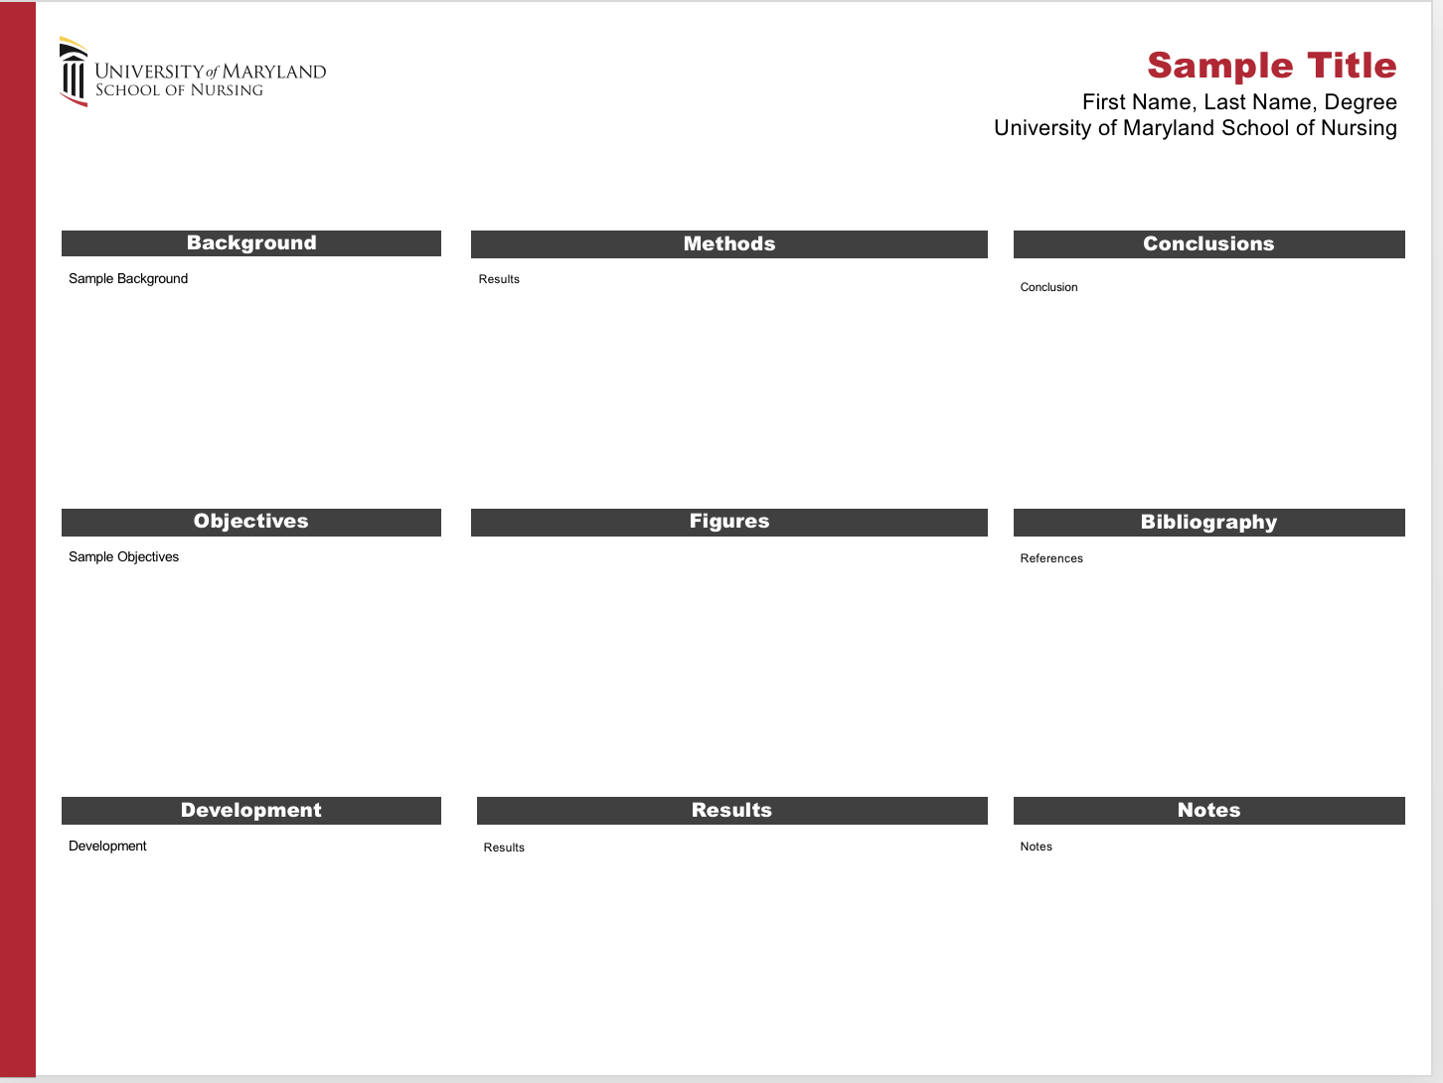
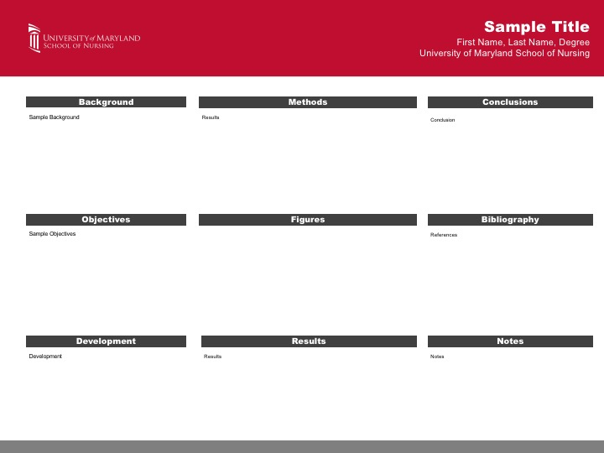
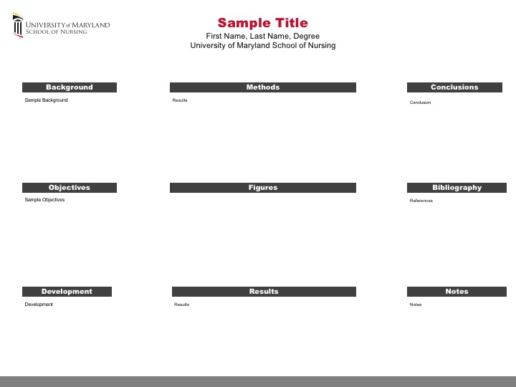
UMSON Poster Templates
Notes:
If you are preparing a professional poster of a DNP project, you are required to use a UMSON template for your poster
However, there are several designs available that students can use. Here are three that are available.
Now, you may think developing your poster’s content is easy – that you just have to cut and paste parts of your final report onto the board, right?
Wrong! To be successful, a poster requires careful planning on how you will depict specific information
And provide text and graphics to capture your audience’s attention.
Posters in which students have cut and paste long paragraphs of text are often very difficult to read and are usually unsuccessful in disseminating any information.

Slide 8

Poster title is one of the most important elements of your poster presentation
Notes:
The title of the poster is very important.
Take some time to think about it and keep the title as short as possible – no more than 15 words!
It is the one part of your poster people notice first as they walk by. Remember, the poster needs to get the viewer’s attention and convince them that it is worth spending more time.
The title section of the poster should also include your first and last name of the student with previous degrees earned.
You may want to also include the name of the organization in which a project occurred, but be sure you have organizational permission before doing so. Some organizations have policies on reviewing and approving posters before they are disseminated. Be sure to ask about this.
Use the font size recommended in the template - no smaller so that the title is readable from 15 - 20 feet away.
Here is an example of good title that is clear, easily readable, and succinct.

Slide 9
Poster Layout
Headings | Description
Background | Provide a description of the problem and demonstrates its significance.
Aim or Objectives | State the purpose of the project and anticipated short and long-term goals.
Implementation Strategies | Include basic parameters including target sample, setting, duration of implementation, and key interventions.
Results | Include summary data (means, standard deviations, etc.) in clearly labeled tables, graphs and figures.
Discussion with Limitations | Derive directly from the results presented and what was proposed in the aims and objectives. Acknowledge limitations and barriers to practice change.
Conclusions | Summarize clearly and concisely major findings (i.e., what do the results tell you about the ”big picture”?). Suggest key improvements as well as potential for sustainability and as well as potential for project expansion should also be considered.
Selected References | Cite key references integral to your project.
Acknowledgements | Acknowledge Faculty Project Advisor, Clinical Site Representative and Implementation Team Members with their permission.
Notes:
In terms of layout, a standard rule is to use headings – to guide the reader’s eyes in the direction that you wish.
Begin with a brief background statement of the problem.
Be sure to detail the aims or objectives, as well as the purpose of the project
Next, specify the implementation strategies
Then, present the results – often this is done using tables, figures or graphics
The next section is the discussion with limitations. This content should directly derived from the results that were presented.
Then, summarize your major findings.
Finally, add key references and acknowledgements.

Slide 10
Poster Design
Use phrases & bulleted lists rather than complete sentences
Consider size and type of font
no less than 32 pt
Use font built into template or those with similar thickness through the stroke (e.g., Helvetica, Arial or Verdana)
Keep it simple & include empty space
Space Distribution:
text: ~25%
graphics: ~40%
empty space: ~30%
Notes:
Here are few rules to follow in terms of poster design:
Whenever possible, use phrases & bulleted lists rather than complete sentences that highlight significant points – you need to consider that few will take the time to read long sections of text.
The size and type of font are important
The font size for all sections should be at least 32 pt
The most legible fonts are those that have strokes with a similar thickness at all points - Helvetica, Arial, and Verdana are good examples
Keep it simple - draft your text and then pare it down to the least amount of words that gets over the message.
It is suggested that 25% of poster should be made up of text
40% - graphics, such as images, tables or figures
30% - empty space - empty space actually makes the poster more approachable rather than overwhelming.
You should also think about the margins – at a minimum you should leave about an inch for margins between poster's content and the edge.

Slide 11
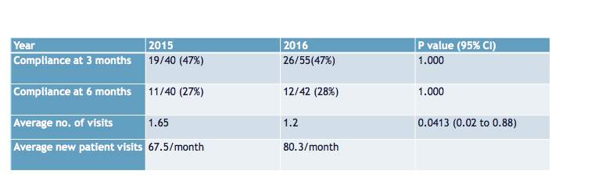

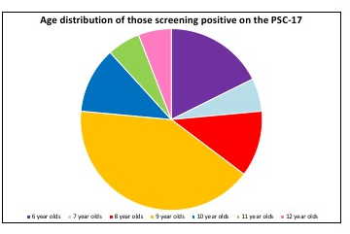
Tables, Figures, Graphs & Images
Notes:
The next few slides will focus on the use of visuals.
I mentioned earlier that the results section of a poster is a good place to include data in a visual format - Because data is where you want the audience’s eyes to go.
The best way to make that happen is to use tables, figures, graphs or images to attract the audience to the poster and to tell a story or show data in a quick easy to follow format.

Slide 12
Make key information stand out
Table 1. Errors in staging per wound type (n = 33)
Wound Type | No. (Percent)
Stage II pressure ulcer | 1 (3%)
Stage III pressure ulcer | 2 (6.1%)
Stage IV pressure ulcer | 0
Unstageable infected pressure ulcer | 17 (51.5%)
Eschar pressure ulcer of heel | 3 (9.1%)
Acute surgical wound | 7 (21.2%)
Graft | 2 (6.1%)
Arterial ulcer | 7 (21.2%)
Venous stasis ulcer | 7 (21.2%)
Diabetic foot ulcer | 10 (30.3%)
Notes:
It is important to make key information stand out.
In the table on the left, the key findings are highlighted by the use of red ovals.
In the table on the right, a bold font and different color direct the viewer’s attention and highlight important information - but in a way that it is not distracting to the viewer.

Slide 13

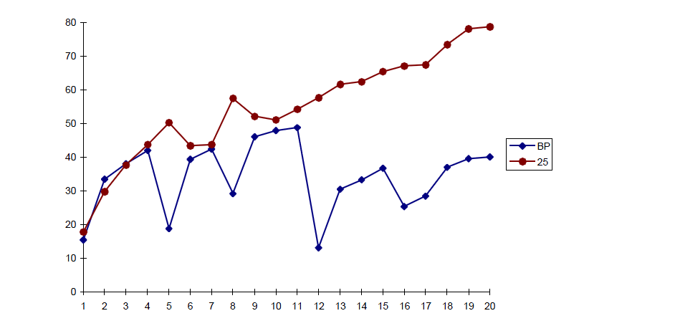

Framing Objects
Notes:
Objects, such as tables, figures or images, can be enhanced with the use of a contrasting background or border.
If necessary for emphasis, add a single additional color by mounting the figure on a slightly larger background
The rule is to use a light background with darker photos; and in contrast, use a dark background with lighter photos.

Slide 14
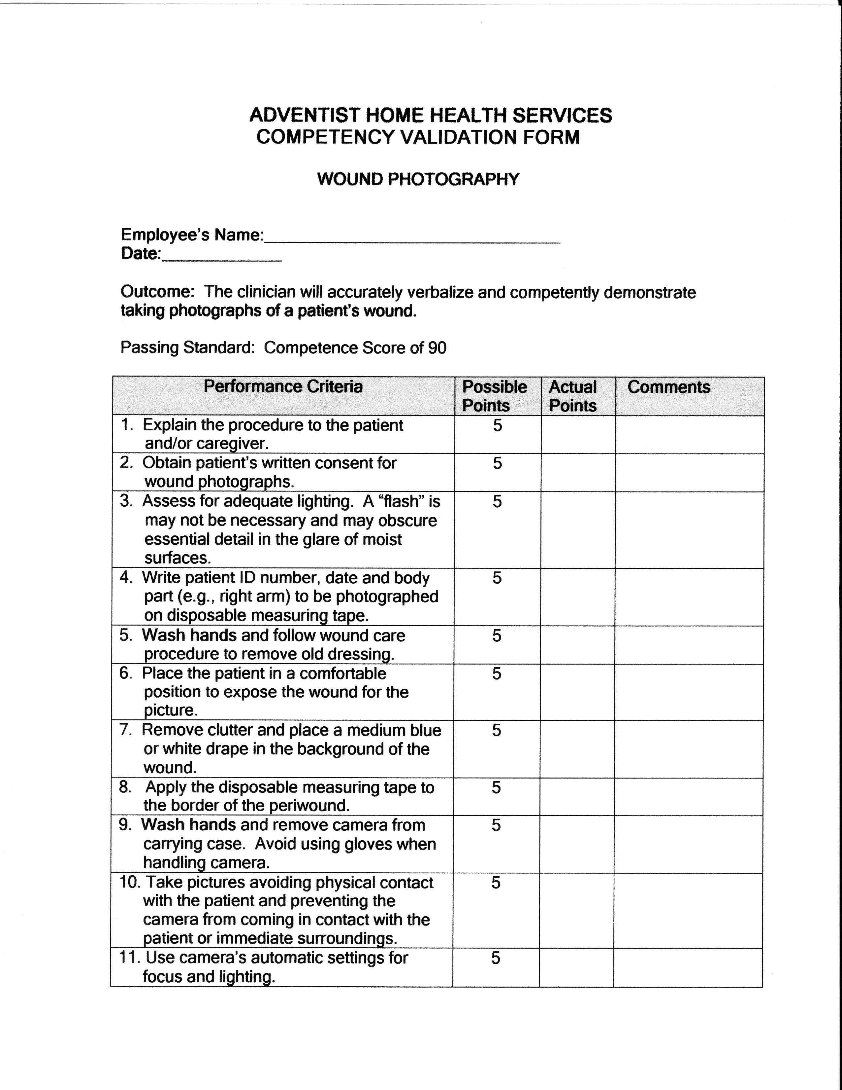
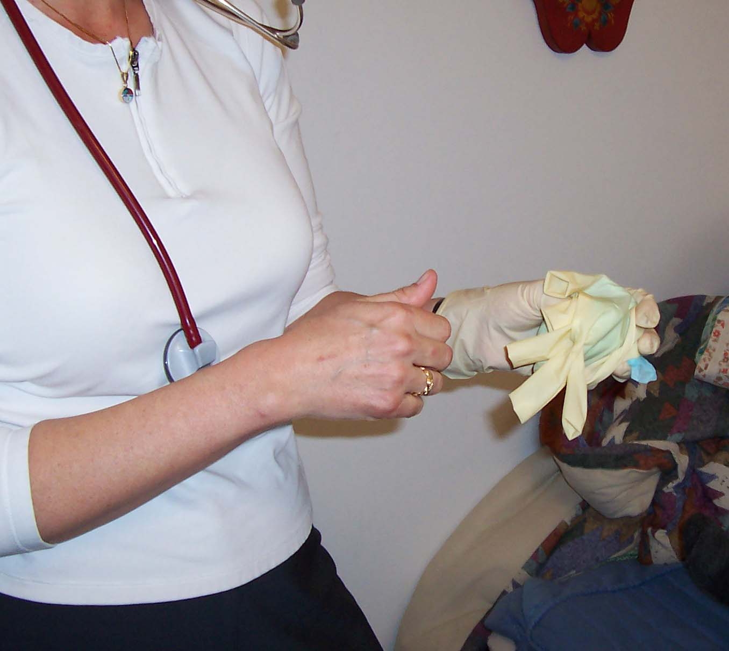
A Picture is Worth a 1,000 Words
Wound Photography Competency
Physical
Assessment
Confidentiality
Wound
Photography
Competency
Infection
Control
Documentation
Patient
Consent
Camera
Technique
Avoid using camera with gloves
Notes:
You may also want to consider using other visuals to send a message – such as the use of Smart Art, call outs, or even a copy of a form to emphasize the project.
The rule again is not to overdue, and take care that whatever you do is adding to the message and not serving as a distraction.

Slide 15
Questions? Shared Lessons? Want to contribute to or develop any of these Briefs?
QI Brief
Email:
NRSDoctoral@umaryland.edu
Notes:
That completes the presentation.
The QI Briefs are being developed as a resource for faculty and students. Please let us know if you have any suggestions or questions.
Or if there are any topics that you think should be added.
Your collaboration and support is greatly appreciated. Together we will achieve our goal To expand the expertise of the University of Maryland’s Faculty and Students in the education of and use of quality improvement and safety concepts, methods, and tools.
Thank you for completing this presentation!

